Slide 1
C
= Concatenation
Conv
Up sample
DEYOLO Backbone
p8
Thermal
p6
p4
Conv
Pool + dropout
Linear
output
DECA + DEPA
DECA + DEPA
DECA + DEPA
C
DEYOLO Backbone
p4
p6
RGB
p8
Conv
Up sample

Slide 2
DEYOLO Backbone
2x
3x
1x
6x
1x
6x
1x
Conv
C2f_BiFocus
Conv
C2f
Conv
C2f
Conv
3x
C2f
p4
p6
p8
C2f_BiFocus
2x
Conv
Bottleneck
Bi-focus

Slide 3
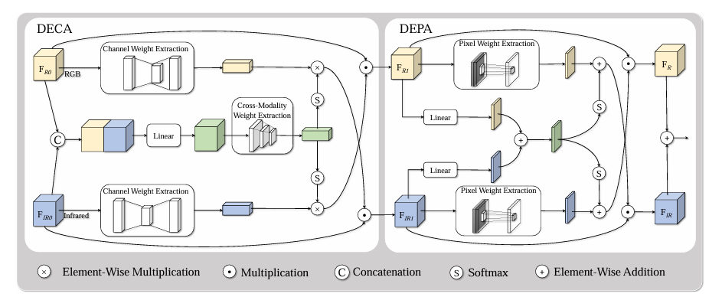

Slide 4
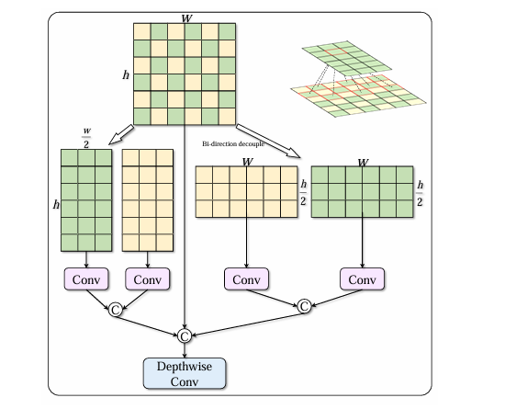
Bidirection
Decouple
(Bi-Focus)

